Slide 1
John Roberto Vibrant Faith

Slide 2
John Roberto Vibrant Faith Leadership Team jroberto@lifelongfaith.com www.LifelongFaith.com SeasonsofAdultFaith.com FamiliesattheCenter.com www.VibrantFaith

Slide 3
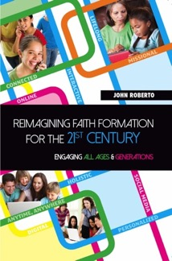
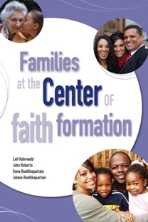
Lifelong Faith Books

Slide 4
Vision to Reality – Lifelong Faith Formation
A New Faith Forming Ecology for the 21st Century
Practices for 21st Century Faith Formation
Designing a Lifelong Plan for Faith Formation: New Models and Strategies
Using New Digital Methods and Resources in Faith Formation
Designing an Online Platform for Faith Formation Programming
Curating Religious Content and Experiences
Introducing Faith Formation Innovations into Church Life

Slide 5
Workshops & Webinars
Program 1: Reimagining Faith Formation for the 21st Century
Program 2: Envisioning Lifelong Faith Formation in Faith Communities
Program 3: Designing New Projects in Lifelong Faith Formation
Program 4 (Webinar): Implementing a Faith Formation Plan
Program 5 (Webinar): Launching a Faith Formation Plan
Program 6: (Webinar): Reviewing Progress
Program 7. (Gathering): Sharing Reports on Models and Impact

Slide 6
What’s Your Vision (Dream, Hopes) for Faith Formation in Your Parish Community?

Slide 7
Part 1. Adaptive Challenges

Slide 8
Life Span Diversity
0-10
50s
20s
30s
40s
60s
70s
80s
90s
11- 19

Slide 9
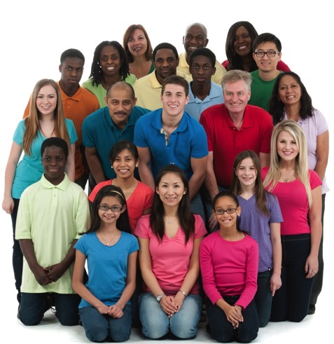
Five Generation Diversity
iGeneration (2000-
Millennials (1980-99)
Generation X (1961-1979)
Builders (before 1946)
Baby Boomers (1946-60)

Slide 10
Generations
iGeneration (2000-
Millennials (1980-99)
Generation X (1961-1979)
Builders (before 1946)
Baby Boomers (1946-60)
Relationship to Institutions
Relationship to Authority
Family Relationships
Work-Life Balance
Communication Style
Technology Usage
Learning Style
Spiritual Expression
Worship Style

Slide 11
Family Diversity
Married Couple + No Children
Married Couple + Children (biological or blended)
Single Parent + Children
Unmarried Couple + Children or No Children
Same Sex Couple + Children or No Children
Multigenerational Family (young adult, grandparents)
Grandparents as Primary Caregivers

Slide 12
Families Today
Diversity of family structures and a variety of living arrangements from 0-18 years old
Pressures of work and finances; majority of mothers work outside home
Increasing complexity of family life, managing/balancing time and commitments
New generation of parents: Millennial parents & young Gen X
Decline in religious practice at home, and decline in participation and affiliation in churches
Decline in faith transmission and practice at home

Slide 13
A Diversity of Spiritual Religious Identities
Not Spiritual, Not Religious
Unaffiliateds
The Spiritual but Not Religious
Uninvolved
Faith & Engagement – one among many priorities
Occasionals
Faith & Engagement at the Center of Life
Actives

Slide 14
Canadian Spiritual Religious Identities
Reject Religion (26%) No-Religious seldom or never participate, yet 50% identify with a religious tradition
Middle (45%) Low-Religious infrequent participation, but identify with a religion, open to involvement
Embrace Religion (30%) Pro-religious involved, pray, read the Bible, feel God cares about them, feel God’s presence

Slide 15
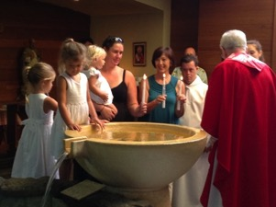
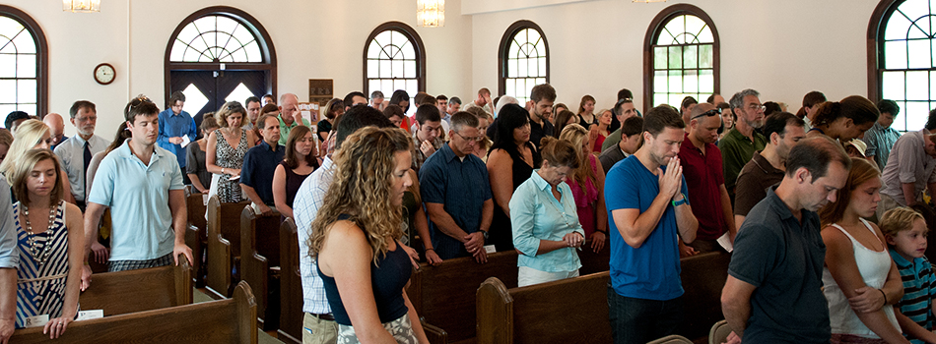
Decline in Religious Socialization & Practice

Slide 16
Digital Transformation

Slide 17
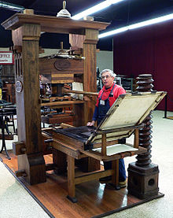
Technological Revolution: The Print Era (1500s - )

Slide 18
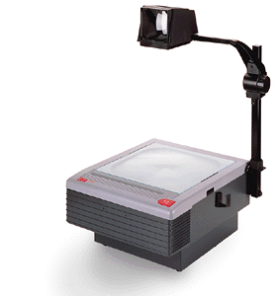
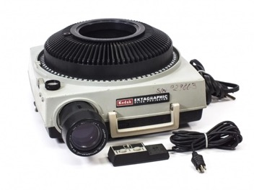
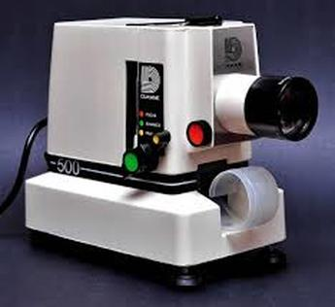
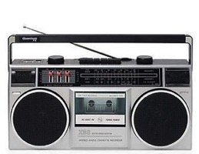
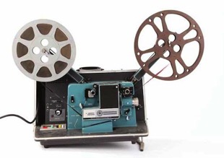
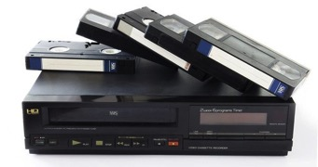
Technological Revolution: The Multimedia Era (1960s - )

Slide 19
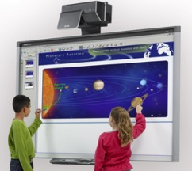
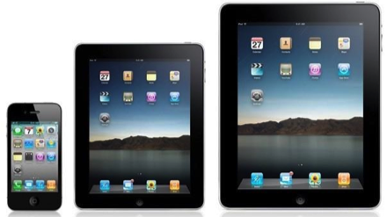
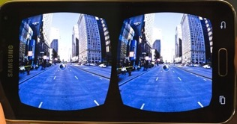
Technological Revolution: The Digital Era (2000s -)

Slide 20
Technological Revolution: The Digital Era (2000s -)

Slide 21
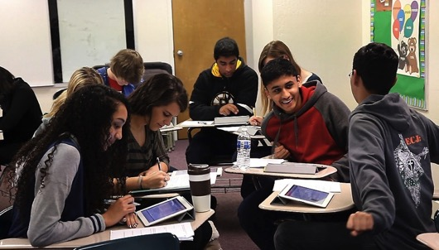
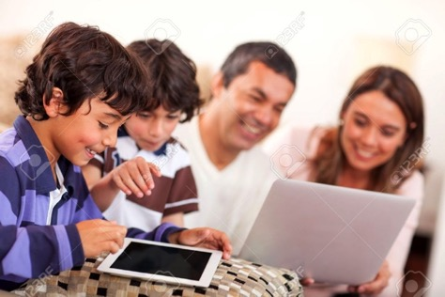
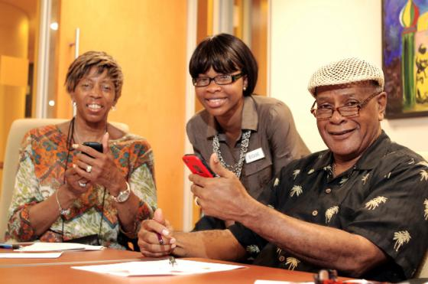

Slide 22
Digital Culture
Digital culture is transforming every aspect of life.
People have the technology and know how to use it.
People have time in their busy lives to connect, participate, and interact in online experiences and communities.
People are already engaged in online learning and online spiritual experiences.
People have access to an abundance of content – in all types of media formats – on demand, just in time, available 24x7, and often free!

Slide 23
What is the Digital Transformation Making Possible in Learning & Faith Formation?
Mobile faith formation – anytime, anyplace, 24x7
An abundance of high quality digital content for faith formation – audio, video, print, websites, digital learning platforms, apps, etc.
Personalizing faith formation – putting the person at the center of faith formation – not the program
Provide multiple ways to learn
Develop content in smaller units (micro-learning) that connect together
Content and tools to extend and expand faith formation in multiple environments
Self-organizing communities of learning and practice

Slide 24
The Adaptive Challenges of 21st Century Faith Formation
Ten decades of the life cycle
Five unique generational identities
Diverse family forms and styles
Diverse spiritual-religious identities of people
Decline in religious transmission and practice at home and decline in participation in church life and programs
Digital culture: new technologies and media create transformation in every aspect of life

Slide 25
Part 2. Reimagining Faith Formation

Slide 26
Reimagining Faith Formation
A New Ecology of Faith Formation
Faith Maturing across the Life Span
Faith Forming Environments
Intergenerational Relationships and Community
Family Faith Practice @Home
Life Stage Faith Formation
Digitally Enabled Faith Formation
Personalizing Faith Formation: Pathways & Playlists
New Leadership Roles

Slide 27
1. A New Faith Forming Ecology
Digitally Enabled and Connected
Faith Forming Ecology
Inter-genera-tional
Family
Life Cycle
Missional
Digitally Enabled and Connected
Digitally Enabled and Connected
Digitally Enabled and Connected

Slide 28
2. Maturing in Faith
Addressing the unique life tasks, needs, interests, and spiritual journeys of people at each stage of life.

Slide 29
Focus on Maturing in Faith: Toward What Ends Are We Working
Youth
Midlife Adults
Children
Young Adults
Mature Adults
Older Adults

Slide 30
Maturing in Faith
The definitive aim of catechesis is to put people not only in touch, but also in communion and intimacy, with Jesus Christ. Starting with the "initial” conversion of a person to the Lord, moved by the Holy Spirit through the primary proclamation of the Gospel, catechesis seeks to solidify and mature this first adherence. It proposes to help those who have just converted "to know better this Jesus to whom he has entrusted himself: to know his 'mystery', the kingdom of God proclaimed by him, the requirements and comments contained in his Gospel message, and the paths that he has laid down for anyone who wishes to follow him.”
(Roman Catholic, General Directory for Catechesis, 80)

Slide 31
Maturing in Faith: Holistic
A way of the head (inform) demands a discipleship of faith seeking understanding and belief with personal conviction, sustained by study, reflecting, discerning and deciding, all toward spiritual wisdom for life.
A way of the heart (form) demands a discipleship of right relationships and right desires, community building, hospitality and inclusion, trust in God’s love, and prayer and worship.
A way of the hands (transform) demands a discipleship of love, justice, peace-making, simplicity, integrity, healing, and repentance.
(Thomas Groome)

Slide 32
Maturing in Faith: Holistic (Roman Catholic, National Directory for Catechesis)
Christ’s method of formation was accomplished by diverse yet interrelated tasks. His example is the most fruitful inspiration for effective catechesis today because it is integral to formation in the Christian faith. Faith must be known celebrated, lived, and expressed in prayer. So catechesis comprises six fundamental tasks, each of which is related to an aspect of faith in Christ.
Promote Knowledge of the Faith – Teach the “basics” of the faith as revealed in the signs of creation, Sacred Scripture, Catholic tradition and human experience.
Liturgical Education – Teach about the form and meaning of the liturgy and the sacraments and help individuals prepare their minds and hearts to enter into these mysteries of our faith.

Slide 33
Maturing in Faith: Holistic (Roman Catholic, National Directory for Catechesis)
Moral Formation – Teach the moral teachings of the Church which are the fulfillment of the Commandments.
Teaching to Pray – Teach that a “climate of prayer” and participation in prayer invites individuals into a personal relationship with Jesus Christ.
Education for Community Life – Teach that the human person needs to live in society. Society is not optional, but a requirement of human nature.
Missionary Initiative – Teach that all Christian service is an expression of love and is performed by Christians for the purpose of building up the Kingdom of God on earth.

Slide 34
Focus on Maturing in Faith
Search Institute, 1988
Spirit & Culture of YM, 2005
Trusting and believing
Seeking spiritual growth
Integrating faith and life
Holding life-affirming values
Experiencing the fruits of faith
Nurturing faith in community
Advocating for social change
Acting and serving
Seeking Spiritual Growth
Possessing a Vital Faith
Practicing Faith in Community
Making the Christian Faith a Way of Life
Living a Life of Service
Possessing a Positive Spirit
Exercising Moral Responsibility

Slide 35
Focus on Maturing in Faith
Sustaining a personal relationship with Jesus Christ supported through regular prayer, faith sharing and Bible reading.
Making the Christian faith a way of life by integrating their beliefs into the conversation, decisions, and actions of daily life.
Possessing a vital faith and being aware of God present and active in their own life, the lives of others, and the life of the world.

Slide 36
Focus on Maturing in Faith
Seeking spiritual growth by actively pursuing questions of faith, learning what it means to believe in God, and what it’s like to be a disciple of Jesus Christ.
Living a life of service by caring for others, reaching out those in need, and addressing injustice in the world.
Sharing the Good News through words and actions, through Christian stewardship and working for peace, justice and human dignity.

Slide 37
Focus on Maturing in Faith
Participating fully, consciously, actively and regularly in the ritual and worship life of the faith community.
Articulating the fundamental teachings of the Christian faith and demonstrating a commitment to learning and growing in this faith.
Exercising moral responsibility by applying Christian ethics, virtues, principles, values, and social teaching to moral decision-making, life situations, and in interactions with the larger culture.

Slide 38
Focus on Maturing in Faith
Practicing faith in Jesus Christ, privately and publicly, through participation in the congregation’s worship, ministries, and leadership.
Discerning and using their gifts to actively belong to and participate in the life and mission of the Christian community.
Exploring God’s call to vocation through prayer, reflection, and discernment.
Possessing a positive spirit with loving and hopeful attitudes toward others and life, convinced that they can make the world a better place.

Slide 39
Maturing in Faith
We need to focus faith formation on the essential characteristics of lifelong growth in Christian faith and discipleship. These characteristics would incorporate knowing and believing, relating and belonging, practicing and living. With a lifelong vision of maturing faith we could address each characteristic in developmentally-appropriate ways at each stage of life.

Slide 40
Maturing in Faith
For example: if “sustaining a personal relationship with Jesus Christ supported through regular prayer, faith sharing and Bible reading” was one of these faith maturing characteristics, the task of faith formation would be to ask how we can accomplish this with children, youth, young adults, midlife adults, mature adults, and older adults. In this approach we would build our “curriculum” around the people and the faith maturing characteristics.

Slide 41
Multiple Ways to Foster Faith Maturing
Maturing in Faith
Approach
Approach
Approach
Approach
Approach

Slide 42
3. Aligning Faith Forming Environments
Intergenerational
Family
Peers
Children & Adolescents

Slide 43
Forming Faith: Intergenerational
Utilize intergenerational events
Connect the generations
Infuse intergenerational into existing programs
Create intergenerational new programs & experiences (learning, service, community life)

Slide 44
Intergenerational Learning Process
Preparation: knowledge & practices for participating fully
Guided Participation: in the events of church life & the Christian Faith
Reflection: on the experience and living its meaning in daily life

Slide 45
Intergenerational Faith Formation
Example: If we are creating a plan for children’s faith formation, we need to consider how we will:
engage children in faith community experiences with all generations (including worship)
equip parents to share faith at home and build families of faith practice.
build relationships with and engage children and parents who are not involved in the faith community (e.g., baptized but not engaged).
Then we can identity the unique age-group experiences we need to provide children.

Slide 46
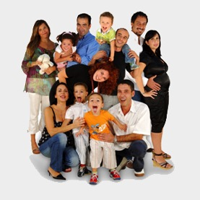
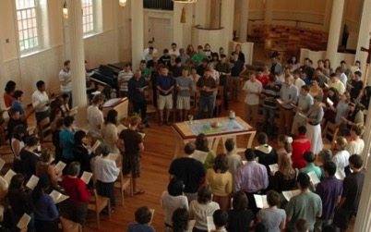
Forming Faith: Family
Primary Influence on transmission of religious faith and practice: Parents & Family
Day-to-day religious practices of the family and the ways parents model their faith and share it in conversation, collaboration, and exposure to outside religious opportunities
Secondary Influence: The Congregation and Significant Adults

Slide 47
What Makes a Difference?
The primary mechanisms by which Catholic identity becomes rooted in children’s lives are not Catholic schooling or sacramental preparation, but rather the day-to-day religious practices of the family and the ways parents model their faith and share it in conversation, collaboration, and exposure to outside religious opportunities.
(Burtkus and Smith)

Slide 48
What Makes a Difference?
This is all to say that the definitive causal agents in the religious and spiritual outcomes of American youth are neither clergy nor youth ministers, neither educators nor the voices of popular culture and media, but parents.
(Burtkus and Smith)

Slide 49
What Makes a Difference?
Parents by the power of their personality, practices, and way of being, model and generate the culture of the household (both explicitly and implicitly).
Parents produce, induce, and interpret the household’s experiences of Christian faith.
Parents are one influence among others - they are nevertheless the dominant influence which orders and shapes the way children experience other influences, i.e. they constellate children’s experiences of various cultural currents, including religion.

Slide 50
One of the most basic suggestions of our findings is that young adults arrive at a sense of their fundamental identity and worldview not by weighing all possible intellectual arguments for and against a proposed way of life, but rather by roughly adopting the worldview of those mentors who left the deepest impression upon them—and who loved them and cared for them the most. It should come as no surprise, then, that the emergence of the new generation of dedicated young Catholics will rise and fall with the choices of their parents.
(American Catholic Religious Parenting, Burtkus and Smith)

Slide 51
Parental Influence
Parent Role
Sponsor of the Faith point of access between church home
Gatekeeper of the Faith control over how much and what sorts of religious content their children encounter
Interpreter of the Faith meaningful embodiment of the Christian faith in the lives of children

Slide 52
Family Faith Formation
Family Faith at Home
Family Engagement in the Intergenerational Faith Community
Family Life & Parent Formation

Slide 53
Family Faith Formation
God in Everyday Life
Faith Practices at Home
Milestones
Seasonal Events
Encountering God in the Bible
Intergenerational Connections
Strong Family Life
Parents & Grandparents as Faith Formers

Slide 54
Family Faith Formation Plan
Young Children
Older Children
Young Adolescents
Older Adolescents
Family Faith @ Home
God in Everyday Life
Faith Practices
Milestones
Intergenerational Faith Community
Seasonal Events
Bible through the Year
Intergenerational Connections & Experiences
Family Life & Parent/Grandparent Formation
Strong Family Life
Parents & Grandparents as Faith Formers

Slide 55
Forming Faith: Life Stage Faith Formation
Seasons of Life
Life Issues
Young Children
Older Children
Young Adolescents
Older Adolescents
Young Adults (20s-30s)
Midlife Adults (40s-mid 50s)
Mature Adults (mid 50s–75)
Older Adults (75+)
Physical & Cognitive Changes
Developmental Tasks
Family Life Cycle
Faith Development
Spiritual-Religious Identities
Generational Characteristics

Slide 56
Generations
iGeneration (2000-
Millennials (1980-99)
Generation X (1961-1979)
Builders (before 1946)
Baby Boomers (1946-60)
Relationship to Institutions
Relationship to Authority
Family Relationships
Work-Life Balance
Communication Style
Technology Usage
Learning Style
Spiritual Expression
Worship Style

Slide 57
4. Digitally Enabled Faith Formation

Slide 58
Multi-Environment Faith Formation
Faith Formation
Church
Daily Life
Community
Home
Online

Slide 59
Digitally Enabled Strategies

Slide 60
Digital Faith Formation Strategies
Extend a church event or program
Design one event or program, offer it in multiple platforms
Prepare for and follow-up an an event or experience
Flip a gathered program
Integrate online and gathered
Create online only experiences
Use webinars, Facebook live, podcasts, etc. to deliver programming directly to people

Slide 61
Transforming Our Approach
Providing an abundance of content & experiences developed around the needs and lives of adults available on demand, 24x7
Using multiple environments: independent, mentored, at home/daily life, small group, large group, church-wide, and in the world
Building a digital platform that integrates all faith formation content and experiences seamlessly
Using digitally-connected strategies to enhance and expand all faith formation programming
Designing episodic engagements and micro-learning experiences
Creating personalized pathways for adult faith formation

Slide 62
5. Personalizing Faith Formation

Slide 63
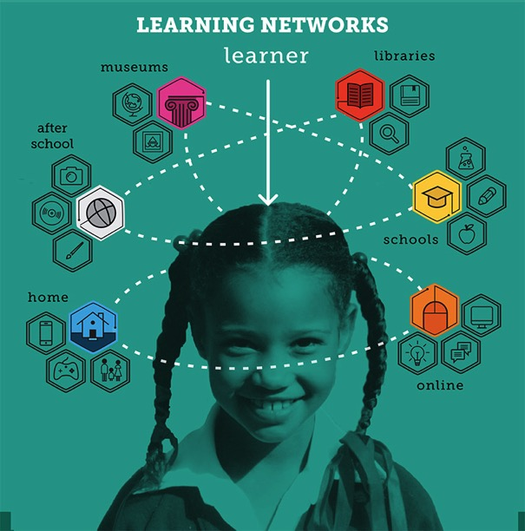

Slide 64
Virtual Learning Academy

Slide 65
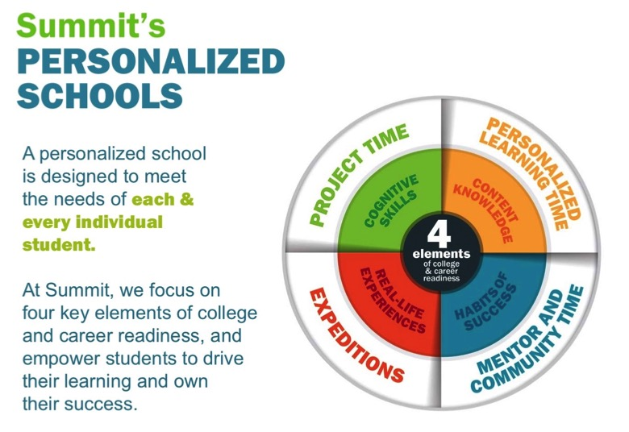
Summit Schools

Slide 66
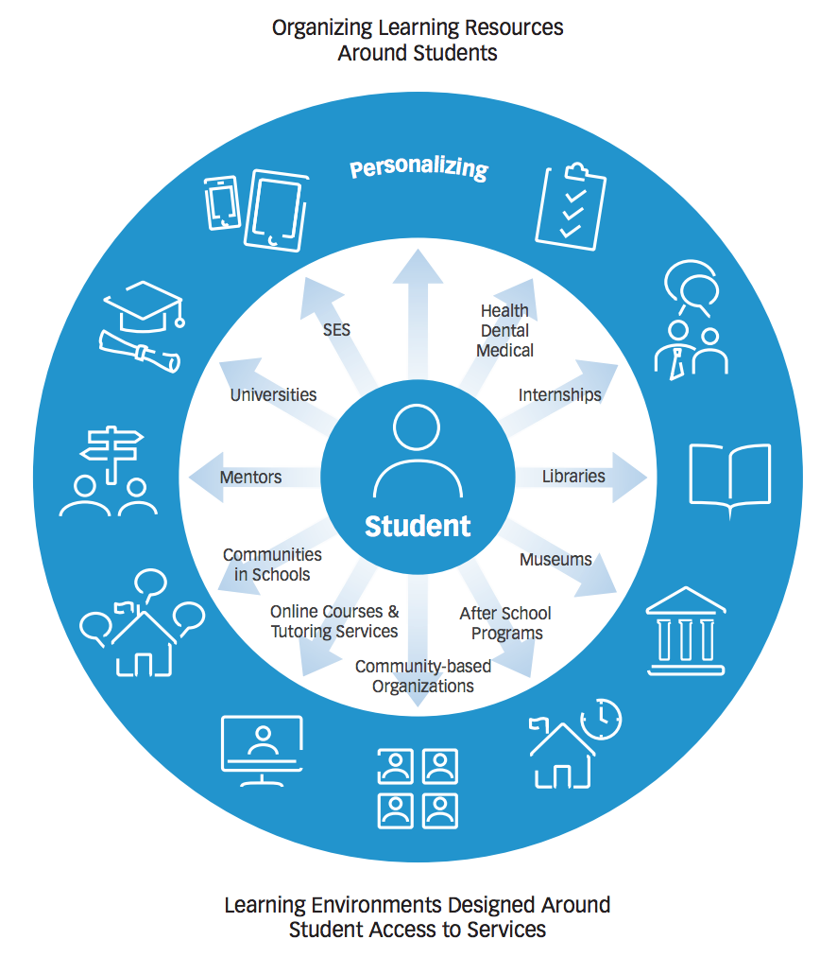
Personalizing Learning
Personalized learning is tailoring learning for each student’s strengths, needs and interests— including enabling student voice and choice in what, how, when and where they learn— to provide flexibility and supports to ensure mastery of the highest standards possible.

Slide 67
Two Ways to Approach Personalizing
Approach One: Personalize the Pathway for People
Develop pathways of faith maturing
Develop playlists of content and experiences tailored to the pathways
Upload playlists to a digital platform
Approach Two: Personalize the Offerings
Identify important life and religious needs of target audience(s) OR develop a pathways model
Develop a digital platform with content to address the needs
Format the content tailored to different spiritual-religious identities

Slide 68
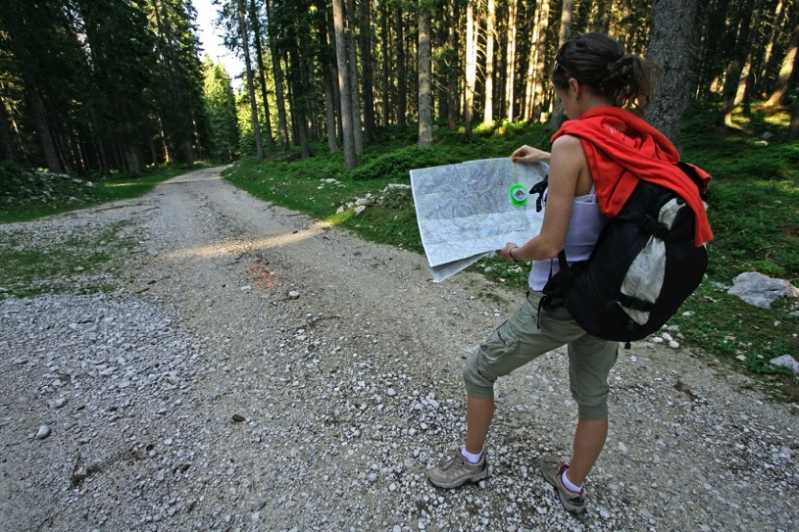
Pathways of Faith Growth

Slide 69
A Pathways Model
A Pathway is a process for helping people discern where they are in their faith journey and to chart a path for faith growth—to get from where they are to a closer relationship with Jesus and a deeper practice of the Christian faith.
A Pathway is life-centered, reaching into every area of a person’s life.
A Pathway is holistic incorporating the whole person: head, heart, and hands.
A Pathway focuses on faith maturing.

Slide 70
A Diversity of Spiritual Religious Identities
Not Spiritual, Not Religious
Unaffiliateds
The Spiritual but Not Religious
Uninvolved
Faith & Engagement – one among many priorities
Occasionals
Faith & Engagement at the Center of Life
Actives

Slide 71
Personalized Pathways of Faith Growth
Pathways
Vibrant
Variety of Experiences & Activities
Occasional
Variety of Experiences & Activities
Uninvolved
Unaffiliated
Variety of Experiences & Activities

Slide 72
Personalized Pathways of Faith Growth
Characteristic
1
Playlist of Experiences & Activities
2
Playlist of Experiences & Activities
3
Playlist of Experiences & Activities
4
Playlist of Experiences & Activities

Slide 73
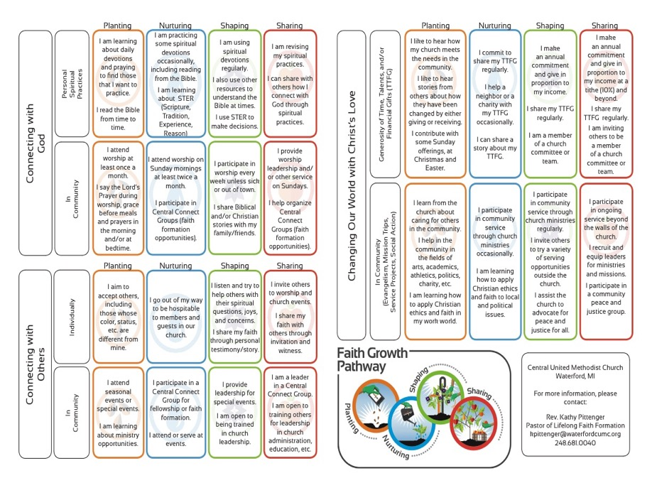

Slide 75
Designing a Pathways Model
Identify a target audience(s)
Describe their life stage & religious-spiritual characteristics.
Identify how/where you will use the Pathways model
Sacraments/milestones
RCIA, evangelization, and new member processes
Gathered adult faith formation programming
Affinity groups
On-ramps where people might start the discipleship journey
Develop the content for the Pathways
Develop a ‘discernment continuum” that gives people a way to reflect on their current growth

Slide 76
Designing Steps 1 & 2 Target Audience & Description
Surveys
Focus Groups
Interviews
Research Reviews
Sample Themes – Mature Adults
Dealing with retirement
Making life plans, finances, health
Becoming a grandparent
Making a difference in the community and world
Incorporating family changes and transitions
New ways of living and relating as a married couple
Caring for aging parents
Taking time to read the Bible and learn more about my faith
Growing spiritually and exploring spirituality for the 2nd half of life
Connecting with people my age; talking about things that matter to us
Dealing with loss

Slide 77
Designing Step 3 - How & Where
Identify how/where you will use the Pathways model
Sacraments/milestones
RCIA, evangelization, and new member processes
Gathered adult faith formation programming
Affinity groups
On-ramps where people might start the discipleship journey

Slide 78
Designing Step 4 – Content Designing Step 5 – Discernment
Develop the content for the Pathways
Life and faith characteristics of the target audience
Characteristics of mature faith
Develop a ‘discernment continuum” that gives people a way to reflect on their current growth
Inquiring--Getting Started--Making Progress--Going Deeper
How true: 1= not true from me , 3=somewhat true for me, 5=very true for me

Slide 79
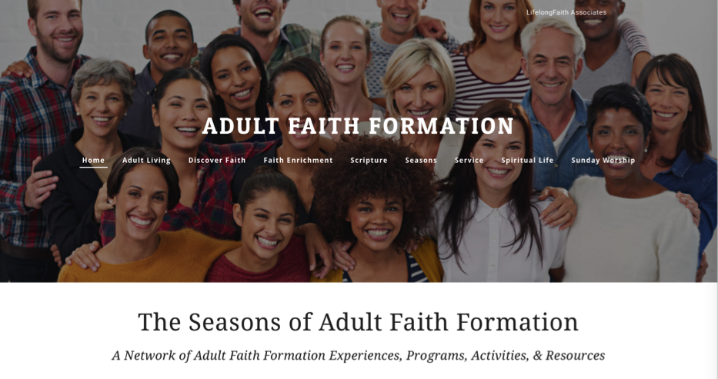
Approach #2. Personalize the Offerings

Slide 80
Personalize
For Life Stage Needs
For Spiritual-Religious Identity
For Interests
For Time People Have for Activities

Slide 81
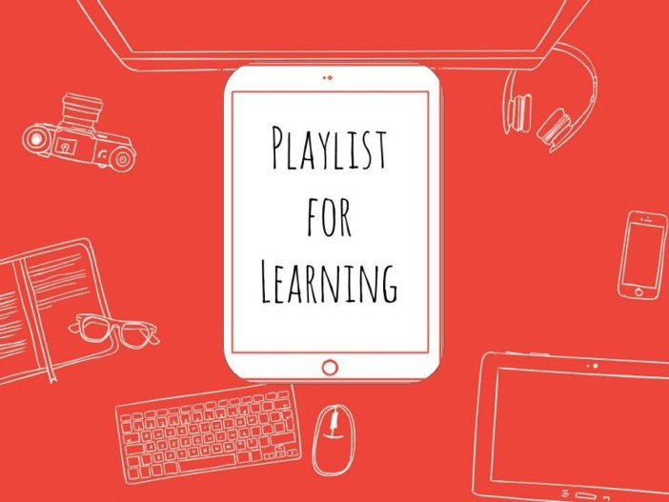
Playlists for Faith Formation

Slide 82
Learning Playlists
A learning playlist is a curated group of digital and local learning experiences and resources (e.g. videos, websites, books, games, articles, etc.).
A playlist weaves together these learning experiences into a sequenced pathway centered on a common theme.
Playlists broaden opportunities to engage in cohesive, interest-driven connected learning experiences that combine a variety of ways to learning: peer settings, family settings, intergenerational settings, community/world settings, and online settings.
Playlists create a rich network of experiences for learners.

Slide 83
Curating Playlists
Books
Audio / Podcasts
Video and movies
Apps and digital programming
Website content and activities
Courses, programs, workshops at church and online
Church life, ministries, and events
Small groups at church, home, community settings
Art, drama, music
Service and action projects, mission trips
Retreats
Field trips
Mentoring

Slide 84
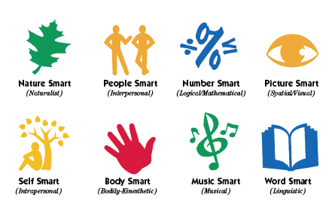
Faith Formation Playlists
Variety of Environments: Self-directed, mentored, at home, in small groups, in large groups, church-wide, in the community, and in the world.
Variety of Ways
to Learn

Slide 85
Playlists of Content & Experiences
If you were to use a Playlist approach to develop the faith of families with young children….
Getting Started Families (little faith experience)
Growing Families (somewhat connected to faith community)
Going Deeper Families (involved and practicing)
How would you engage the parents?
How would you engage the children and whole family?

Slide 86
Playlists of Content & Experiences
If you were to use a Playlist approach for first communion…
Getting Started Children (little to no faith forming experiences)
Growing Children (some faith forming experiences)
Going Deeper Children (involved and practicing)
What would faith formation look like with these three “types” of children?
What would parent and family faith formation look like?

Slide 87
Playlists of Content & Experiences
If you were to use a Playlist approach for confirmation…
Getting Started Adolescents (little to no faith forming experiences since childhood)
Growing Adolescents (some faith forming experiences in childhood)
Going Deeper Adolescents (involved and practicing)
What would faith formation look like with these three “types” of adolescents?
What would parent and family faith formation look like?

Slide 88
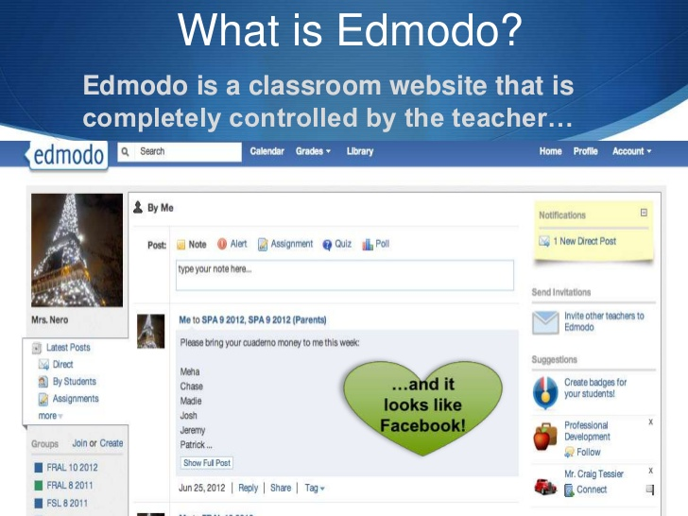

Slide 89
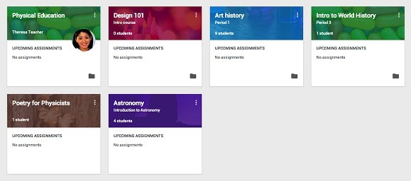
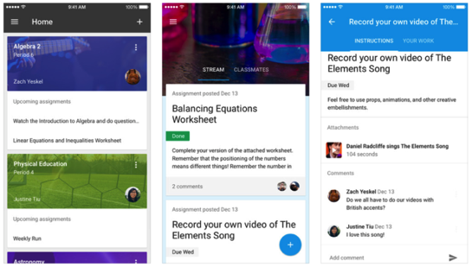

Slide 90
Transforming Our Role
Balancing Both Roles
|---------------------------------------------------------------------------------------------------------|
Current Roles
Emerging Roles
Developing religious content
Designing programming
Managing programming
Teaching/Facilitating programming
Designing faith forming environments—architecture
Designing Digital Platforms for faith forming content
Curating religious content and experiences

Slide 91
New Leadership Roles
We are becoming learning architects who design and/or identify environments which can become settings for faith formation, e.g., homes, workplaces, coffee shops, online communities, and more. We can design content and experiences to “deliver” to that setting.
We are becoming designers of digital platforms (websites, social media) where people can connect with each other, access content, engage in learning activities, and more. These platforms provide 24x7 faith formation.
We are becoming curators of religious content and experiences. When there is an abundance of content, our role shifts from creator to curator. Curators are engaged in finding and identifying high quality content in all formats, matching it with the needs of people, providing the content on a digital platform (and often in gathered settings), and engaging people with the content.

Slide 92
Digital Faith Formation Strategies

Slide 93
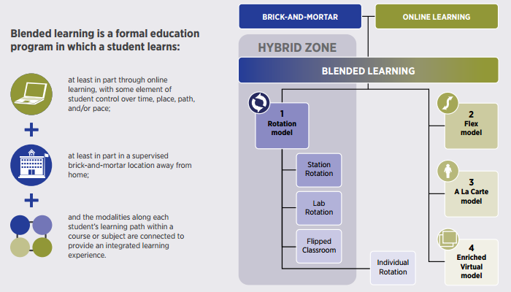
Blended Learning

Slide 94
Digitally Enabled & Digitally Connected Faith Formation

Slide 95
Extend the Event
Church or School Event or Program
At Home & Daily Life

Slide 96
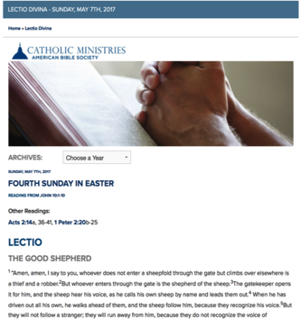
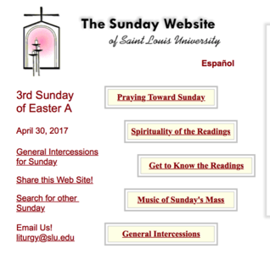
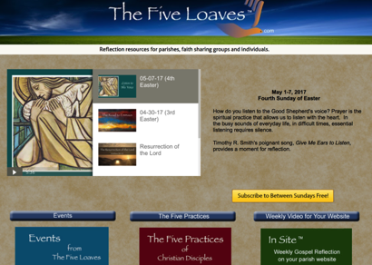
Sunday Worship
Learning
Praying
Reading the Bible: Daily Readings
Living

Slide 97
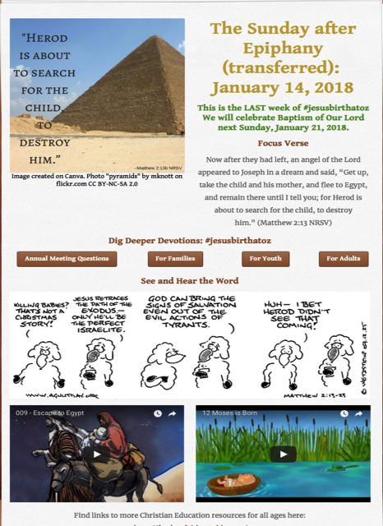
Tri-Saints Lutheran Hardy, NE

Slide 98
One Event/ Program, Multiple Formats
Multiple Formats
Digital Content to Extend & Provide New Ways to Experience
Social Media
Interaction
Communication
Demonstration
Connection
Gathered
Website
Small Group
Independent
Online
Event/Program

Slide 99
Build on an Event/Experience
Preparing
Experiencing
Living
How will you sustain/extend the event?
How will you design the event?
What types of experiences, programming, activities, and resources will you develop to prepare people for the event?
How will you engage age groups, families, and the faith community?
What types of experiences, programs, activities, and resources will you offer people?

Slide 100
Flip the Model
@ Home / Daily Life
Exploring the Content - print, audio, video, activities
@ The Program
Applying the Content: Create – Practice - Perform - Participate

Slide 101
Our Confirmation preparation program has two components: Once a month in-person classes and an online study. The online study is a place for students to develop their faith weekly by completing multi-media lessons which include videos, reading, Saint reflections, multiple-choice questions and online small group discussions. Each small group has their own online space to discuss faith topics, ask questions, and pray for one another. By having both in person classes and an online study we hope to help families learn more about their faith while respecting the many demands for their time.

Slide 102
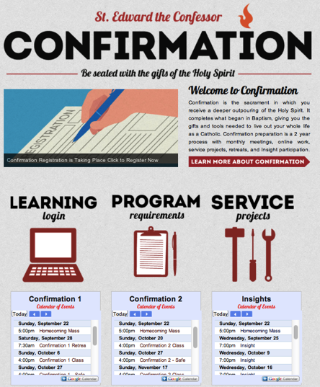
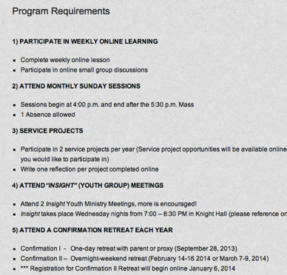
Confirmation

Slide 103
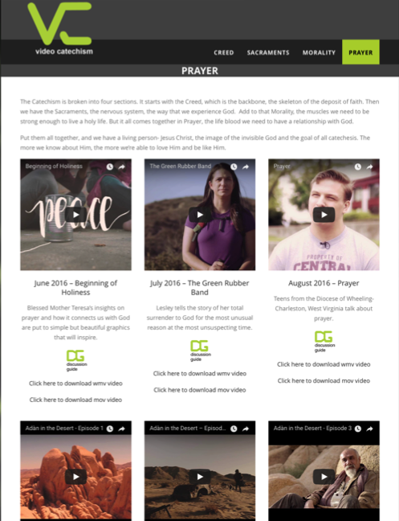

Slide 104
Christian Initiation & New Member Formation

Slide 105
Flip Christian Initiation

Slide 106
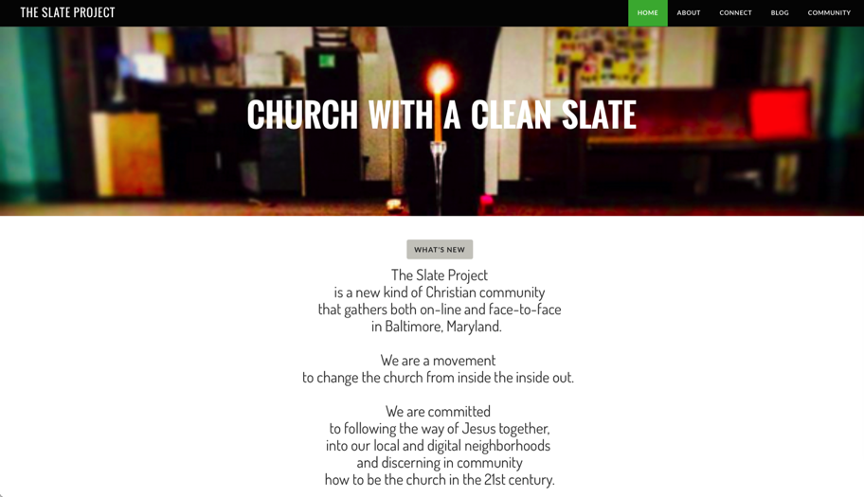
Integrate Online and Gathered

Slide 107
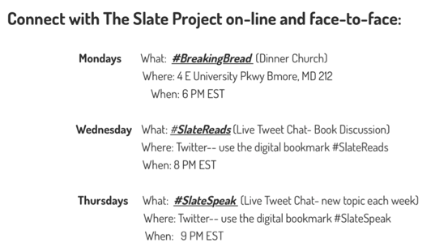
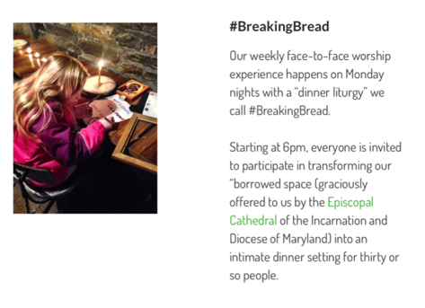

Slide 108
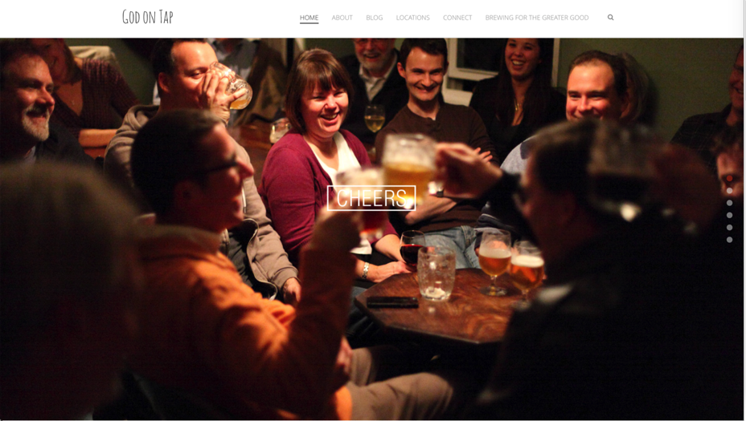
Integrate Online and Gathered

Slide 109
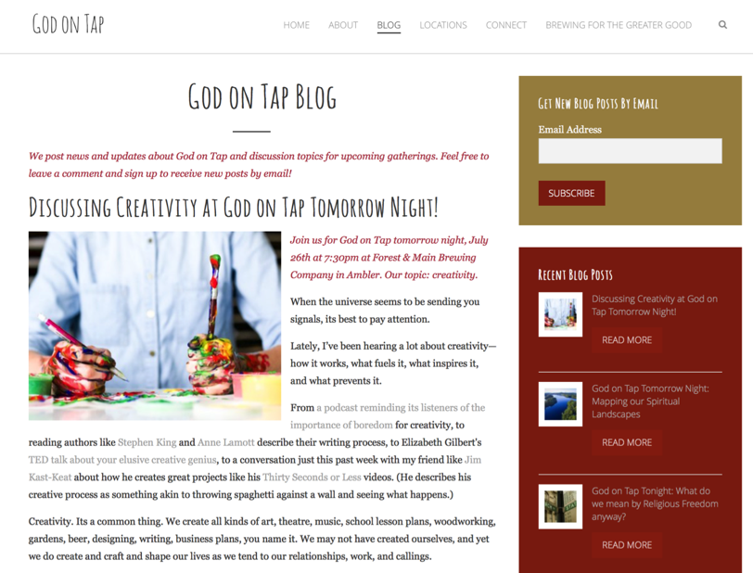

Slide 110
Online 40-Day Lent Curriculum
Church ➔ | Daily & Home | ⬅ Online
Ash Wednesday Lenten Sunday liturgies Stations of the Cross Lenten prayer Lenten retreat Lenten service Lenten soup suppers | Fasting Praying Service/Almsgiving Lectionary reflection Family Lenten activities | Lenten learning resources Lenten calendar Daily Lenten prayer Weekly table prayer Video resources Online retreat experience

Slide 111
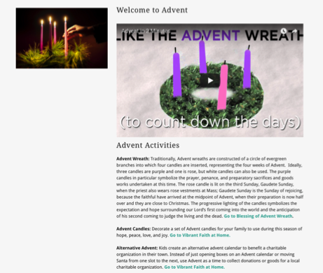
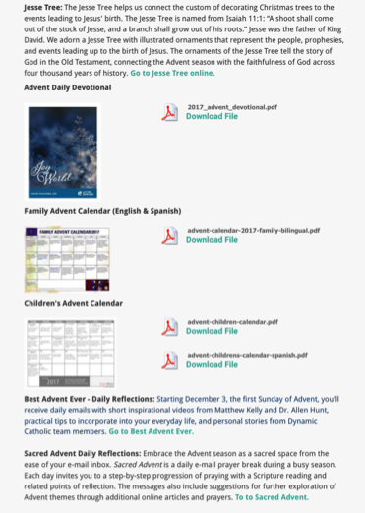
Advent or Lent Online “Curriculum”

Slide 112
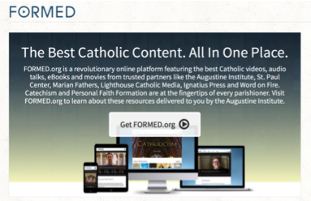
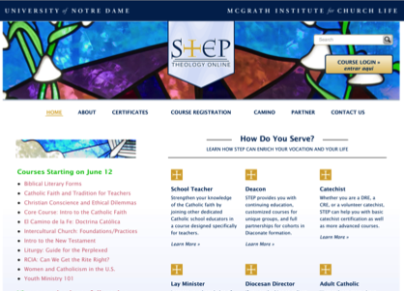
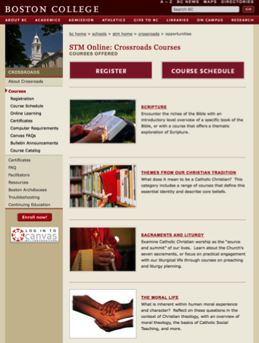
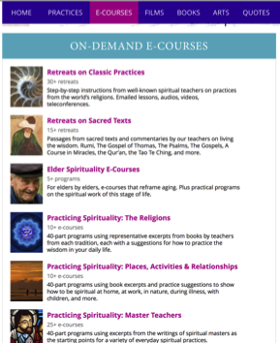
Online Learning

Slide 113
Online Prayer

Slide 114
Webinar Live Presentation Upper Dublin Lutheran Church

